Slide 1
Neural Network
EC500 Learning from data
Mikhail andreev

Slide 2




Introduction
Problem: Classify different handwritten numbers using neural networks.
Input data is from the MNIST Database of handwritten digits

Slide 3
Database Statistics
1000 images for each of the digits 0 through 9
Images are 28x28 pixels of greyscale values.
Images are normalized so values fall between 0 and 1
Goal of neural network is to be able to output the value represented by image.
Same techniques can be applied to other image datasets.

Slide 4
Multi-Layer Perceptron Network
Type of Neural Network
Can be used to perform regression or classification.
Two phases in neural network:
Feed-Forward
Back-Propogation
These two phases are repeated for the examples or epochs

Slide 5
Multi-Layer Perceptron Network
Input
Output
Output Layer
Hidden Layers
Input
Layer

Slide 6
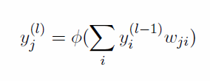
Feed-Forward
Pass an example into the network
The example moves into the input layer, and propagates through each following layer
Each neuron gets the values of the previous layer, multiplied by a weight vector and passed through an activation function.
The values at the end of the output layer form the output.
Weighted sum of
previous layer activations
Activation of node j in layer l
Activation function

Slide 7
Feed-Forward
Input
Output
Output Layer
Hidden Layers
Input
Layer

Slide 8
Feed-Forward
Input
Output
Output Layer
Hidden Layers
Input
Layer

Slide 9
Feed-Forward
Input
Output
Output Layer
Hidden Layers
Input
Layer

Slide 10
Feed-Forward
Input
Output
Output Layer
Hidden Layers
Input
Layer

Slide 11
Feed-Forward
Input
Output
Output Layer
Hidden Layers
Input
Layer

Slide 12
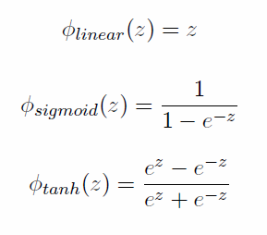
Activation Functions
Several activation functions which determine the non-linear nature of the neural network
Typical activation functions:
Usually for input and output layers, linear activation is used, and for hidden layers, sigmoid or hyperbolic is used.

Slide 13
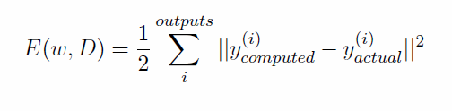
Back-Propagation
Central feature to learning in a neural network.
After you have computed the output values, you get the error from the real value, and calculate the change in weight to minimize that error.
With this error term, you calculate the partial derivatives with respect to the weight, and use this to obtain the needed change in weight.
This is Gradient Descent

Slide 14

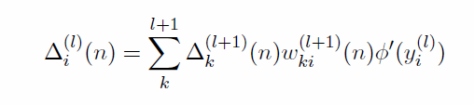
Back-Propagation
The output and hidden layers have slightly different delta values:
Output Layer L
Derivative of
activation
function
Error term
Hidden Layer l
Weighted sum of next layer deltas

Slide 15

Back-Propagation
These are used to calculate the new weights
Current layer delta
Current weight
Previous layer activations
Learning
parameter

Slide 16
Back-Propagation
Input
Output
Output Layer
Hidden Layers
Input
Layer

Slide 17
Back-Propagation
Input
Output
Output Layer
Hidden Layers
Input
Layer

Slide 18
Back-Propagation
Input
Output
Output Layer
Hidden Layers
Input
Layer

Slide 19
Back-Propagation
Input
Output
Output Layer
Hidden Layers
Input
Layer

Slide 20
Back-Propagation
Input
Output
Output Layer
Hidden Layers
Input
Layer

Slide 21
Learning Considerations
Learning parameter determines how fast network learns correct weights.
If its small, correct weights will be learned, but it will take a long time
If it is large, weights might diverge
Learning by pattern vs Learning by epoch
Advanced versions:
Gradient descent with momentum
Adaptive learning rate
Independent step length
Newton’s method (2nd-order Taylor)
Quickprop (approximated Newton’s method)

Slide 22
Convolutional Neural Network
MLP Neural Networks ignore the proximity of pixels, treating all pixels as the same relative to each other
Also difficult to find internal structure
Convolutional Neural Networks designed to find internal patterns based on local patches in images
Using these internal patterns, predict classification
Can be used for more complicated images to find structure

Slide 23
Convolutional Neural Network
Local Receptive Fields – Instead of each input layer connecting to each hidden layer neuron, use localization
Shared Weights and biases
Features map to several feature maps, each detecting different internal patterns
Pooling Layers – Simplify convolutional layer output (ex. Max-pooling)
Pooling layers lead to output
Can use multiple sets of convolutional/pooling layers

Slide 24
Convolutional Neural Network
Input
Pooling Layers
Convolution Layers
Output Layers

Slide 25

Results
Generated with 3 categories, 300 samples each

Slide 26
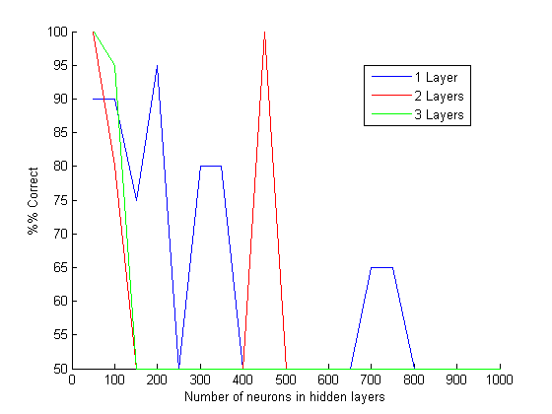
Results

Slide 27
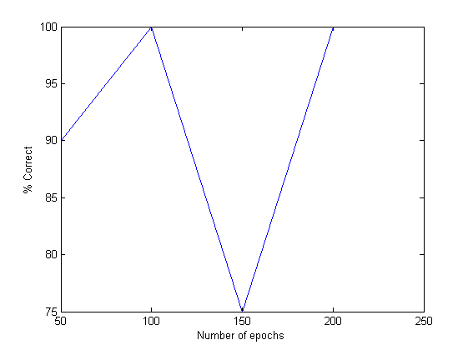
Results

Slide 28
Conclusions
Neural Networks can be very powerful in classifying images.
Convolutional neural networks especially can be used to find complex hidden patterns in images.
However, there are lots of hyper-parameters to discover
Large, deep networks require a lot of time and computation

